Slide 1
Define hardware as consisting of physical components of a computer system
Identify internal hardware devices (e.g. processor, motherboards, random access memory (RAM), read-only memory (ROM), video cards, sound cards and internal hard disk drives.
Identify external hardware devices and peripherals (such as monitors, keyboards, mice, keyboards, printers as input and output devices and external storage devices in general)
Define software as programs for controlling the operation of a computer or processing of electronic data
Identify the two types of software – applications software and system software
Define applications software (e.g. word processing, spreadsheet, database management systems, control software, measuring software, applets and apps, photo-editing software, video-editing software, graphics manipulation software)
Define system software (e.g. compilers, linkers, device drivers, operating systems and utilities)

Slide 2
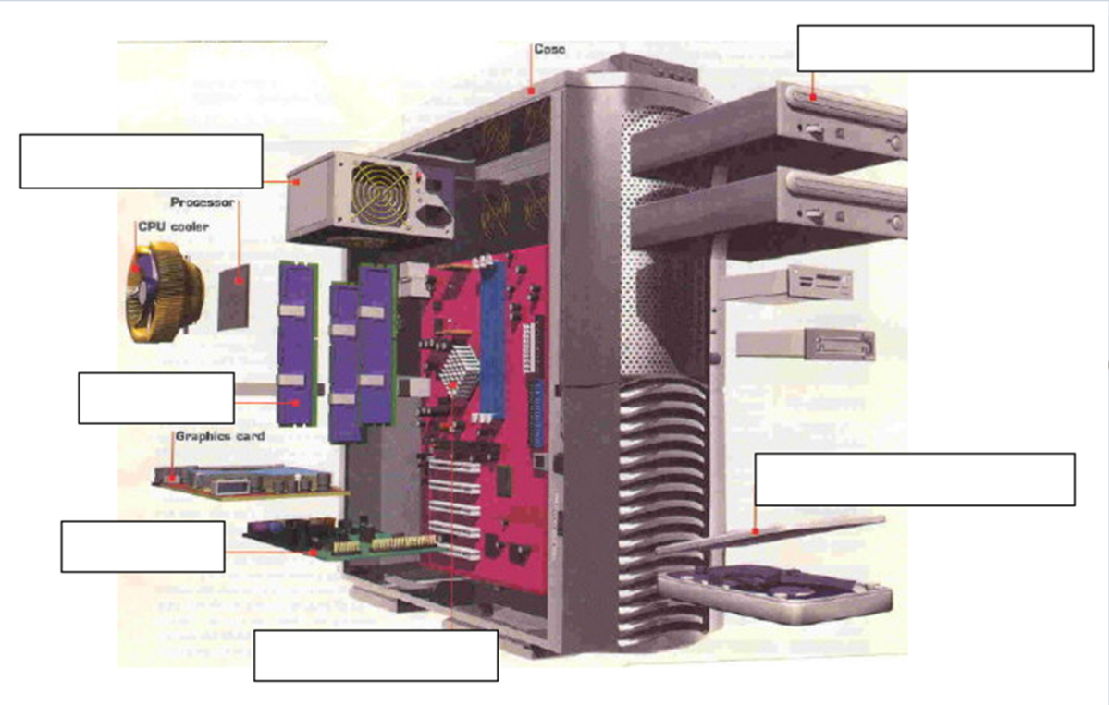
What is Hardware?
Hardware are the _________ components which make up the computer system.
Hardware components can either be _________ or _________.
Internal
External
Physical
Memory (RAM)
Sound/Graphics card
Hard drive
Optical Drive
Motherboard
Power supply

Slide 3
 |  |  |  |  |  |  |  |  |  | 1
 |  |  |  |  |  |  |  |  | 2
 |  |  |  |  |  |  | 3
 |  |  |  |  |  |  |  |  | 4
 |  |  |  |  |  | 5
6
 |  |  |  |  |  |  |  | 7
 |  |  |  |  |  |  |  |  |  |  | 2
 | 8
 |  |  |  |  |  | 1
Across
Holds temporary information processed by CPU
input, process, and deliver audio
Involved in running the computer
To provide a connection to the internet
To provide power to components
Carry's out calculations
To display graphics
Designed to allow users complete specific task.
Down
Storage device
Connects main components.

Slide 4
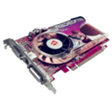

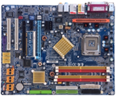
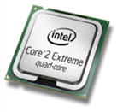
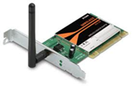

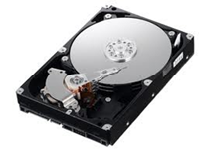
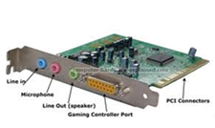
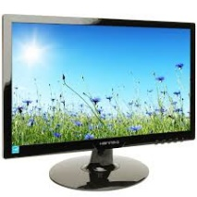
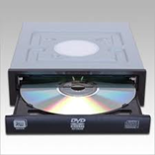
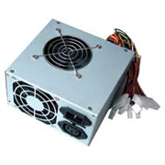
Hardware Components – Please provide a brief description of each component.
Hardware | Overview
Match up the hardware to the most appropriate image

Slide 5
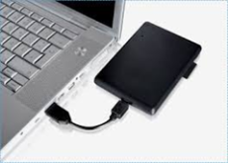
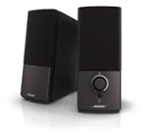
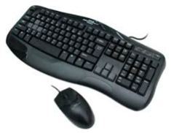
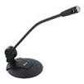
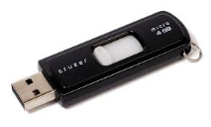
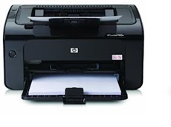
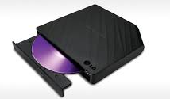
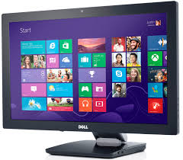
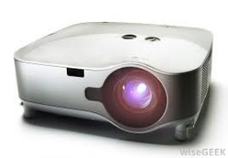
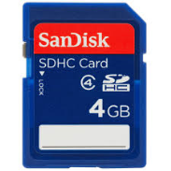
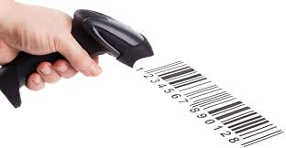
External hardware devices: Place the correct devices in the appropriate category
Input Hardware Devices – Input data into a Computer | Output Hardware Devices – Outputs data from a computer | External Storage Devices – Provides external storage or backup solutions

